Slide 1
Mesoscale Multi-Physics Simulation of Solidification in Selective Laser Melting Process Using A Phase Field and Thermal Lattice Boltzmann Model
Dehao Liu, Yan Wang*
Georgia Institute of Technology yan.wang@me.gatech.edu
http://msse.gatech.edu
IDETC/CIE 2017
August 8, 2017, Cleveland, Ohio, USA

Slide 2
Outline
Background
Methodology
Phase Field Method
Thermal Lattice Boltzmann
Motion of Grain
Simulation Algorithm
Simulation Results
Effect of Flow
Effect of Cooling Rate
Summary

Slide 3
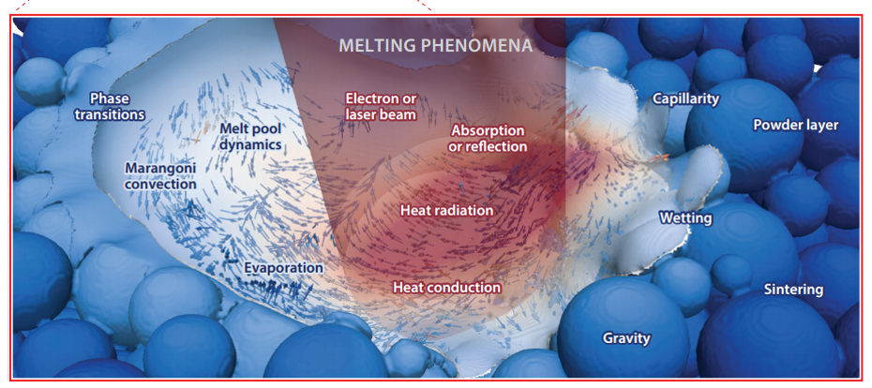
Background
Solidification of melt in SLM process is very complicated, which involves multiple physical phenomena
Challenge: Create a multi-physics based model to investigate the Process-Structure relationship
Markl, M., & Körner, C. (2016)
Notes:
As we all know, selective laser melting (SLM) is an additive manufacturing process by melting metal powders with a laser heating source. Solidification of melt in SLM process is very complicated, which involves multiple physical phenomena, like solute transport, heat transfer, fluid dynamics, phase transition and etc. Right now, there is not a single model to consider so many physical effects at the same time. It is still a big challenge to create a multi-physics model to investigate the Process-Structure relationship during SLM process.

Slide 4
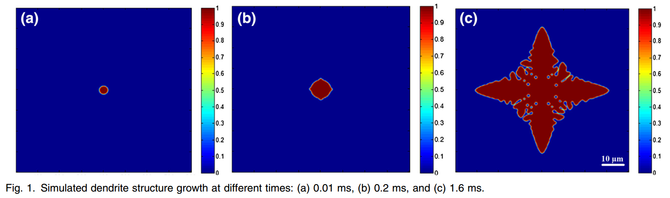
Single-Physics Simulation – Phase Field Method
Phase field method has been used to simulate the microstructure evolution and solute concentration of Ti-6Al-4V alloy during solidification in powder-bed electron beam AM process (Gong & Chou 2015; Sahoo & Chou 2016)
Isothermal assumption without considering the effect of the latent heat
No effect of melt flow

Slide 5
Multi-Physics Simulation – Phase Field + Convection
Navier-Stokes equation to predict fluid flow velocity (Beckermann et al. 1999)
Advection-Diffusion
(Beckermann et al. 1999)

Slide 6
Multi-Physics Simulation – Phase Field + Non-isothermal
Heat transfer with high cooling rates (Loginova et al. 2001; Grujicic et al. 2002; Echebarria et al. 2004)
Isothermal
Non-isothermal
(Loginova et al., 2001)

Slide 7
Multi-Physics Simulation – Phase Field + Convection + Non-isothermal
Navier-Stokes equation is applied to predict fluid flow velocity, thermal conduction (Lan & Shih, 2004; Du & Zhang, 2014; Holfelder et al. 2016)
Advection-diffusion
(Lan & Shih, 2004)

Slide 8
Multi-Physics Simulation – Phase field + lattice Boltzmann method
Lattice Boltzmann method simulates fluid flow (Medvedev & Kassner 2005; Miller et al. 2006; ; Rojas et al. 2015; Bӧttger et al. 2016; Cartalade et al. 2016)
(Medvedev & Kassner 2005)
(Rojas et al. 2015)

Slide 9
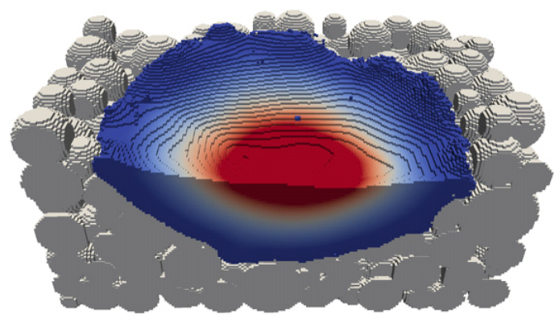
Multi-Physics Simulation – thermal lattice Boltzmann method
3D thermal lattice Boltzmann method to simulate the evolution of temperature and velocity field in electron beam melting processes (Ammer et al., 2014)
The evolution of dendrite structure is not simulated
(Ammer et al., 2014)

Slide 10
Methodology
Phase Field Method
Thermal Lattice Boltzmann
Motion of Grain
Simulation Algorithm

Slide 11
Proposed Multi-Physics Model
Phase Field + Thermal Lattice Boltzmann Method (PF-TLBM) integrates:
solute transport,
heat transfer,
phase transition,
fluid dynamics,
motion of the solid phase
Solute transport
Phase transition
Fluid dynamics
Heat transfer
Motion of grain
Phase Field
Thermal Lattice Boltzmann
Notes:
The basic idea is to combine phased field and thermal lattice Boltzmann method

Slide 12
Phase Field Method
Phase Field Method (PFM) is a versatile and accurate numerical tool to simulate solidification (Boettinger et al., 2002; Chen, 2002; Singer-Loginova and Singer, 2008; Moelans et al., 2008; Steinbach, 2009)
Phase field or order parameter ϕ describes the distribution of phase
Free energy functional drives the evolution of microstructure
Solid
Liquid
Notes:
So, why phase field? Among various simulation models, phase field is a versatile and accurate numerical tool to simulate solidification. The phase field represents the fraction of solid phase at a location. The blue circle represents the solid phase, when fai equals to 1. The yellow rectangle represents the liquid phase, when fai equals to 0. The free energy functional in PFM is composed of two parts.

Slide 13
Our Implemented PFM
Kinetic equation for the phase field
Kinetic equation for the composition field
Advection effect is considered in solute transport and phase transition
Anti-trapping current
Notes:
The anti-trapping current is introduced to eliminate the effect of numerical solute trapping because of the diffusion of the interface.

Slide 14
Thermal Lattice Boltzmann Method
Coupling of melt flow with heat transfer
Kinetic equations for density and temperature particle distributions
Macroscopic quantities of density, velocity, and temperature are calculated from f_{i}’s and g_{i}’s.
Density:
Temperature:
Notes:
So why we choose thermal lattice Boltzmann? The reason is that Lattice Boltzmann method (LBM) has computational advantages over conventional finite volume approaches to solve the Navier–Stokes equations, especially with complex boundaries. Two-density distribution is used in thermal lattice Boltzmann, one is density distribution, and the other one is temperature distribution. For example, when you summing up the temperature distribution, you will get the temperature at a location.

Slide 15
Thermal Lattice Boltzmann Method
Latent heat
Force source
Heat source
weights (for D2Q9)
Notes:
The friction force between solid and liquid interface is considered in the force source term. The release of latent heat is included in the heat source term.

Slide 16
Motion of Grain
Motion of grain includes rigid translation and rotation of the grains.
Total force and torque acting on a grain
Translation of the grain (center of mass)
Rotation of the grain
Local velocity of the grain
Notes:
When you calculate the total force and torque acting on a grain, you can get the local velocity of the grain by these equations.

Slide 17
PF-TLBM Algorithm
Different variables are coupled
The algorithm is implemented in C++ programming language and integrated with OpenPhase
The OpenMP shared-memory parallel programming framework is used to accelerate the computation
Notes:
In PF-TLBM, different variables are coupled with each other. The major ones include phase field , its time derivative , composition , temperature , velocity of liquid , and velocity of solid. For example, after computation of solute transport with FDM, the composition field will be transferred to the calculation of phase transition, and then the phase field will come back. This is how these physical variables couple with each other.

Slide 18
Simulation Results: Al-Cu
A single nucleus is put at the center of Al-4wt%Cu alloy melt flow
Zero Neumann conditions are applied at all boundaries for phase field ϕ and composition C.
For melt flow, periodic boundary conditions are applied at the left and right boundary
Given a constant cooling rate
, a fixed heat flux
is set at the
upper and lower boundaries

Slide 19
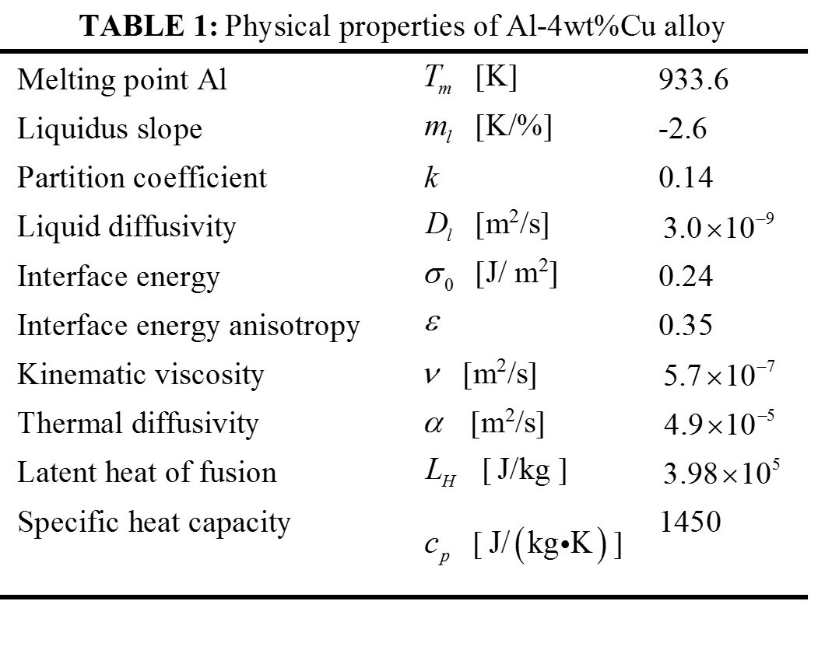
Physical properties

Slide 20
Simulation Results: Al-Cu
isothermal
Non-isothermal

Slide 21
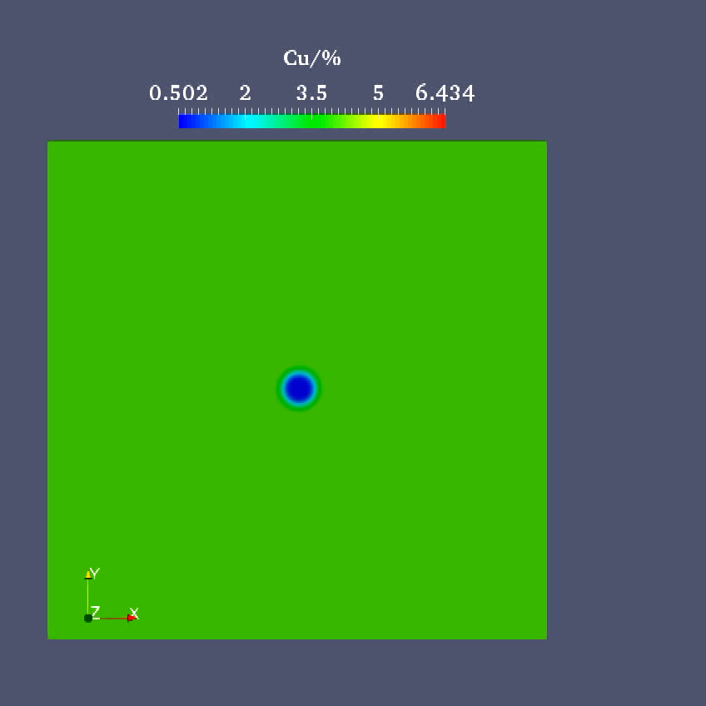
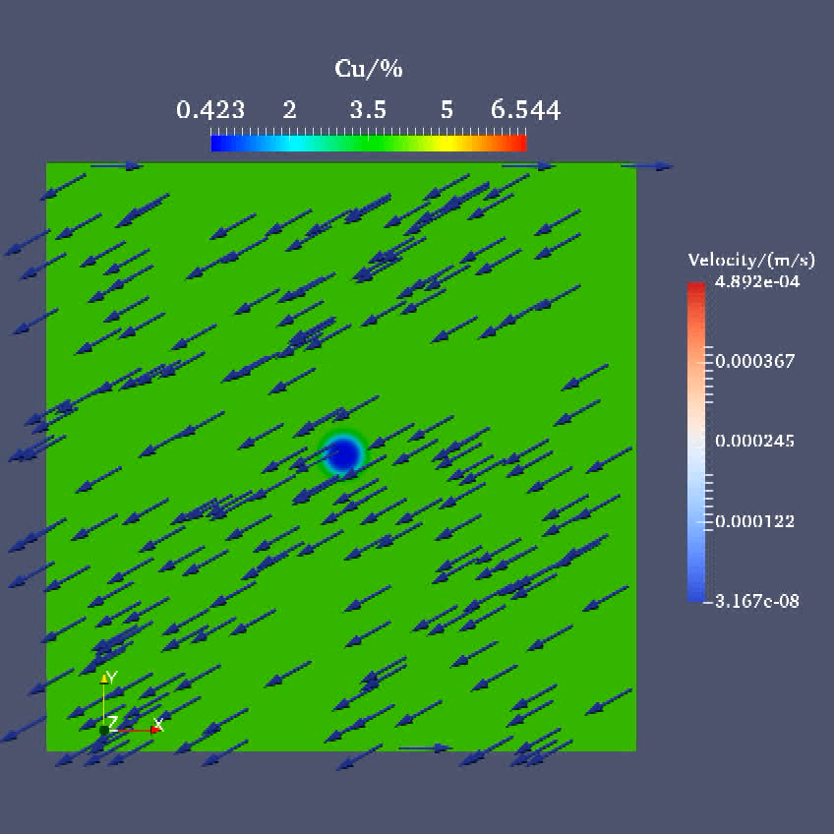
Simulation Results: Al-Cu
Non-isothermal dendrite growth without and with constant flow

Slide 22
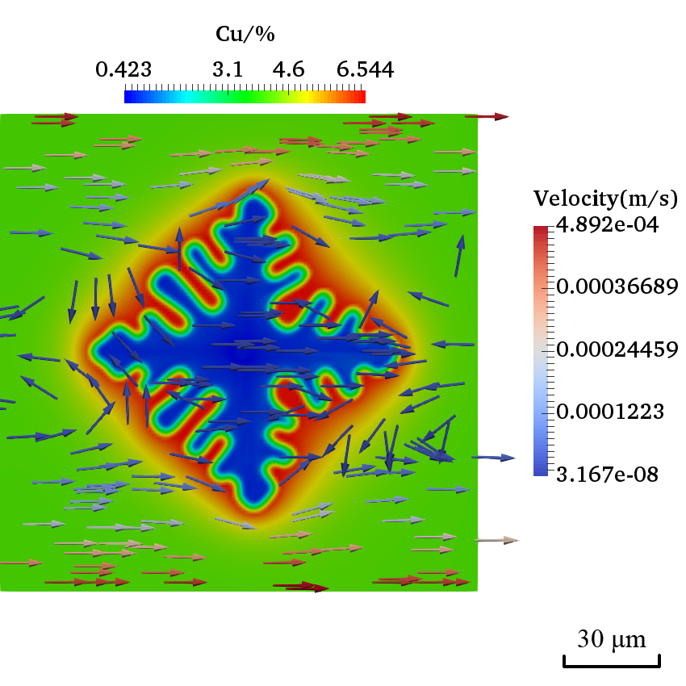
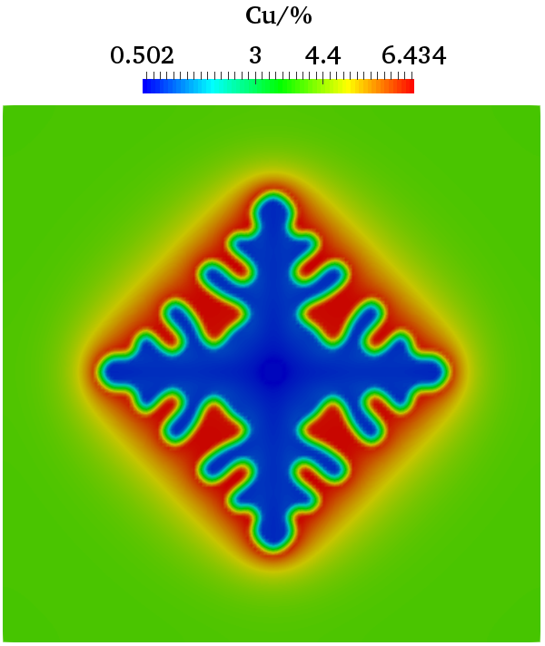
Effect of Flow
With flow, the upstream portion of dendrite grows faster than the downstream portion, and the primary arm against the flow is deflected
100ms
100ms
Notes:
What is the reason for the upstream portion of dendrite grows faster than the downstream portion?

Slide 23
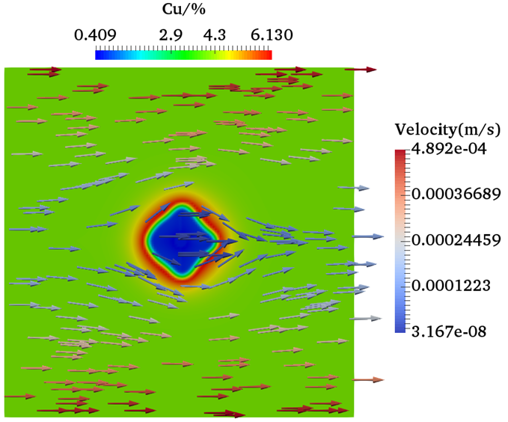
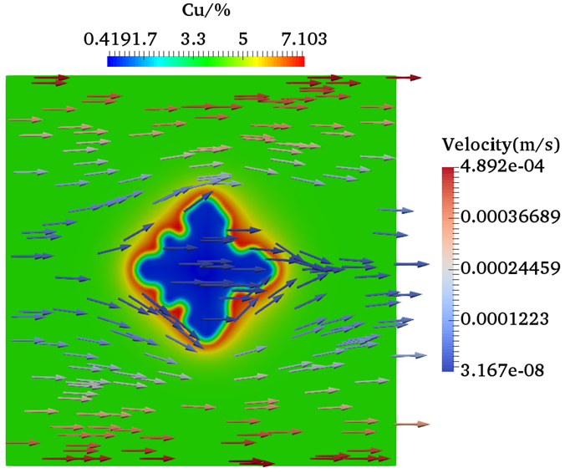
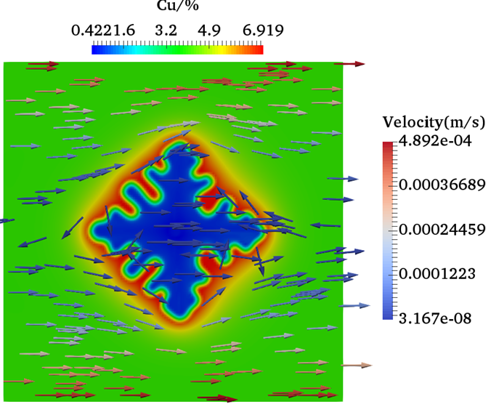
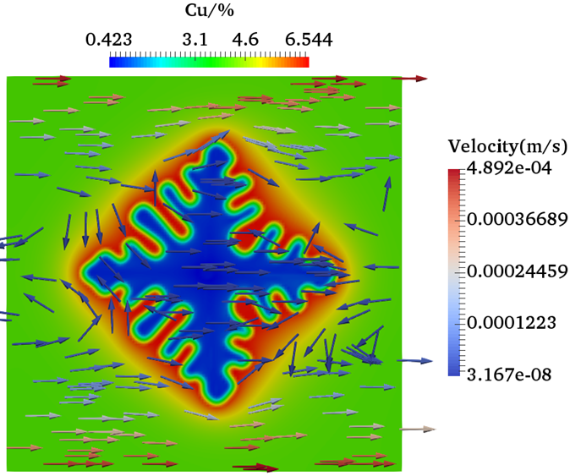
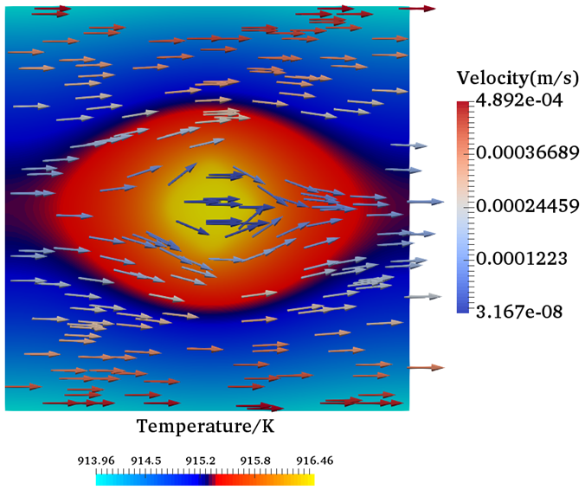
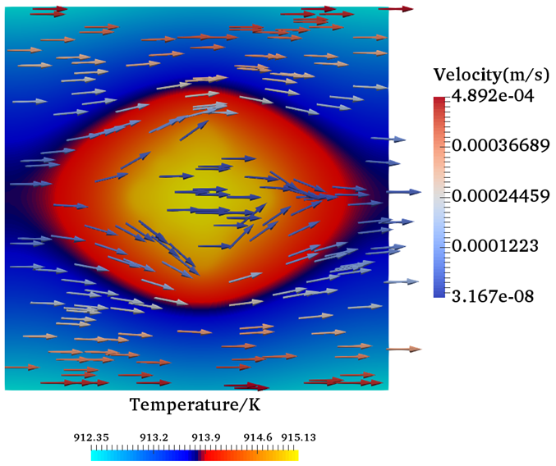
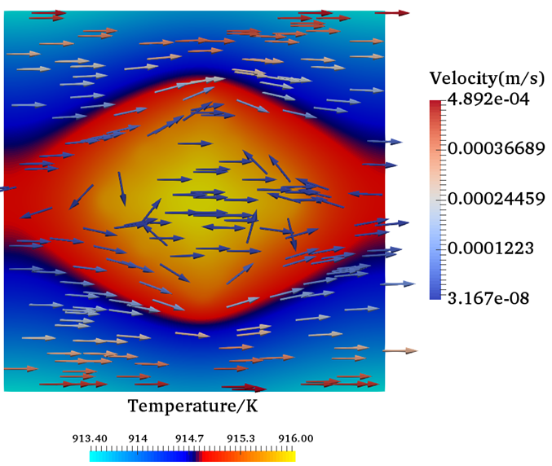
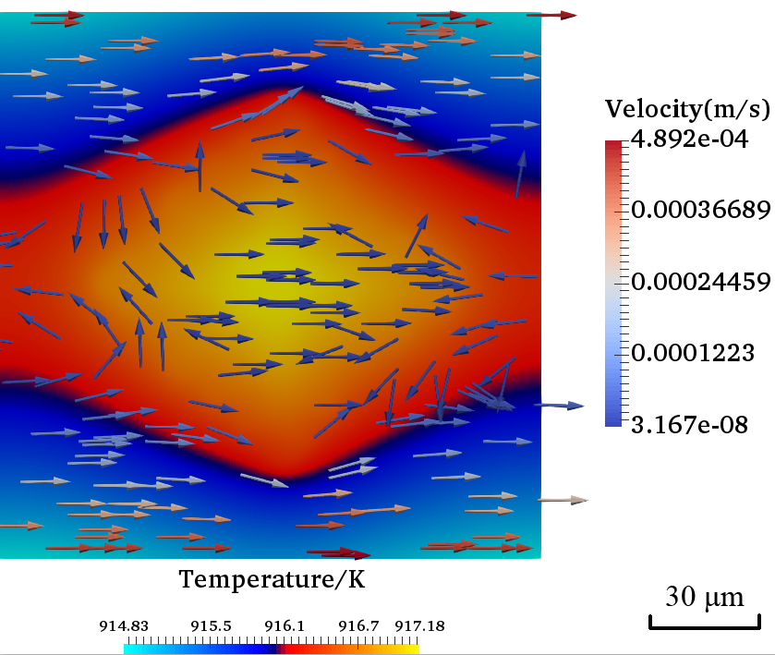
Effect of Flow
The flow brings fresh material to its vicinity, which also increases the undercooling
25ms
50ms
75ms
100ms
25ms
50ms
75ms
100ms
Notes:
The simple answer is that the flow will bring fresh material to its vicinity, which reduce the composition gradient. When the flow cool down the upstream part, it will also increase the undercooling, which increases the driving force for grain growth.

Slide 24
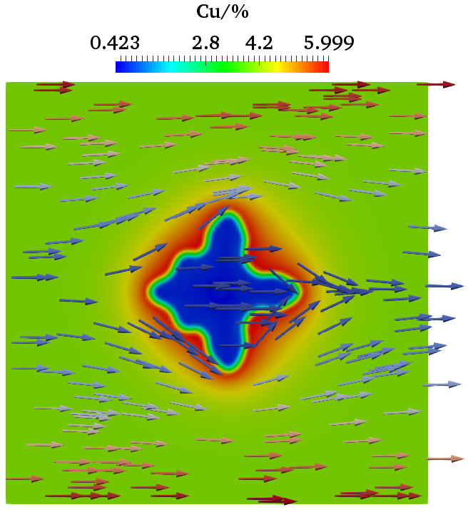
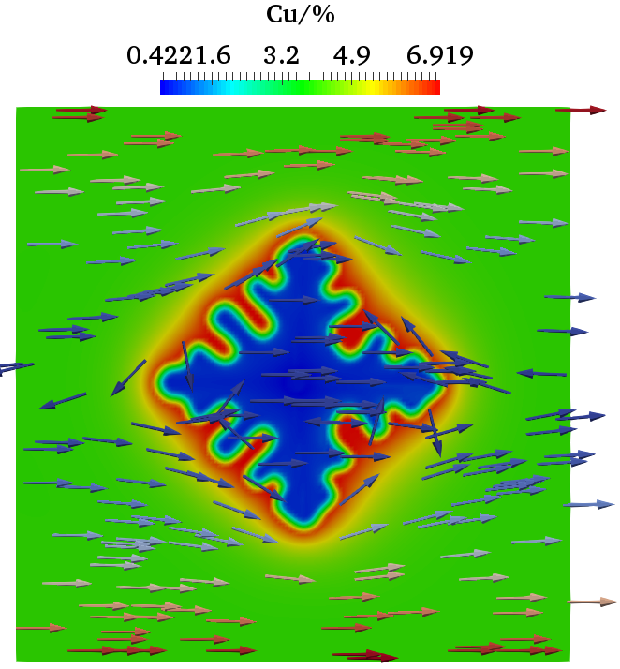
Effect of Cooling Rate
Higher cooling rate increases the growth rate of secondary arms of dendrite
A higher cooling rate also results in higher segregation of Cu at the solid-liquid interface
75ms
75ms
75ms

Slide 25
3D Dendrite Growth

Slide 26
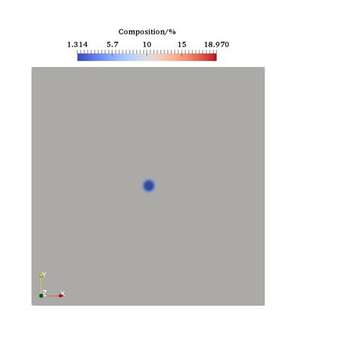
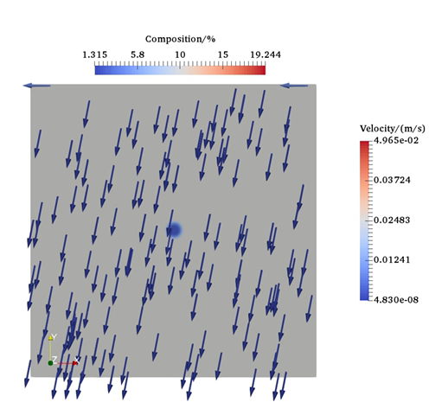
Simulation Results: Ti-6Al-4V
Cooling rate:
Simulation domain: 100 μm* 100 μm
Flow speed: 50 mm/s

Slide 27
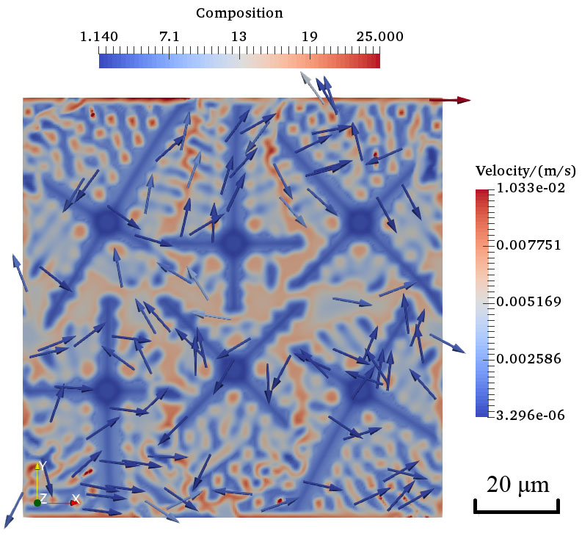
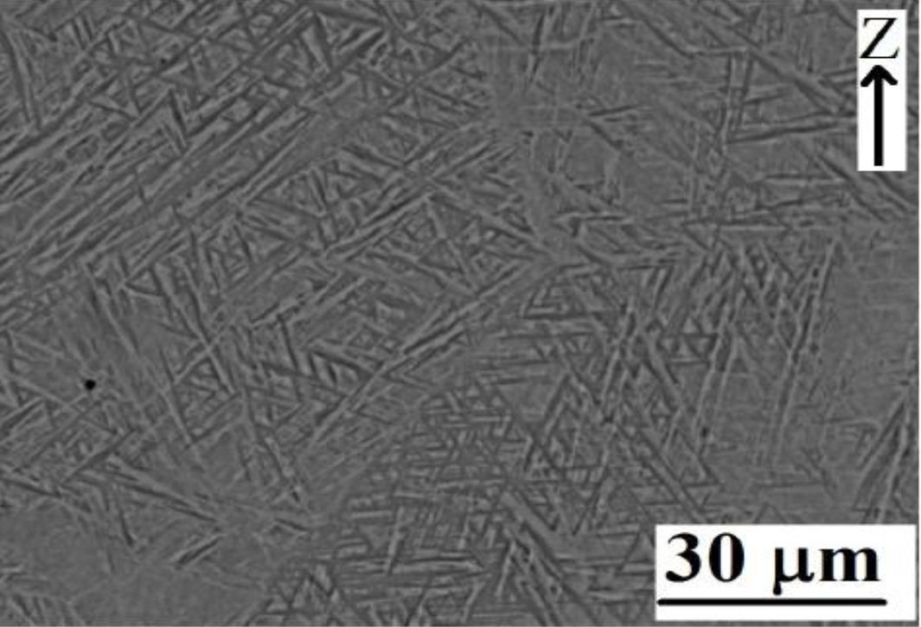
Simulation Results: Ti-6Al-4V
Multigrain growth
Cooling rate:
Flow speed: 50 mm/s
Simulated microstructure
SEM image of Ti64 microstructure produced by SLM
Notes:
Simulated dendrite structure matches the growth pattern in the experimental observation in SLM

Slide 28
Research Issues
How to improve computational efficiency
parallelization
How to improve accuracy
Uncertainty quantification
Parameter uncertainty
Model form uncertainty
How to use simulation in process planning and optimization
Establishing Process-Structure-Property (P-S-P) relationship

Slide 29
Summary
A mesoscale multi-physics model is developed to simulate the solidification process in SLM based on Phase Field and Thermal Lattice Boltzmann Methods
The PF-TLBM model incorporates solute transport, heat transfer, fluid dynamics, kinetics of phase transformation, and grain growth.
It simulates systems at a reasonable time scale for manufacturing processes while providing fine-grained material phase and composition information.

Slide 30

Thanks!

